Slide 1

Cryptology
Liran Hersh – 203955299
Noy Maman – 313594434
Karin Azulay – 316541549
Asaf Darmon - 205404080

Slide 2
Our goal
Secure access to dataset of image files
AES
Image encryption/decryption by MARS In CFB mode
Secure channel for secret key delivery
Encryption/Decryption secret key with EC El Gamal
Digital signature using RSA using
SHA-256

Slide 3

Generate public key + private key
Project Flow
MARS
Encryption for each block
Using CFB mode and special secret key
Alice’s Side
Divide picture pixels to 128-bit blocks
Secret key (MARS KEY)
Encryption
EC El Gamal
Digital signature using RSA algorithm with SHA-256
Re-Build the decrypted blocks into an image.
MARS
Decryption
Algorithm using CFB Decryption Mode
Bob’s Side
MARS Secret Key Decryption
Digital signature Check

Slide 4
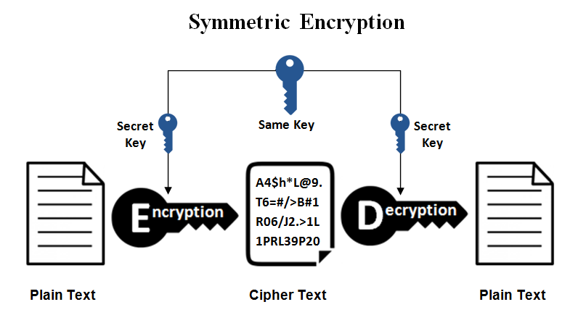
Symmetric key
Symmetric-key algorithms are algorithms for cryptography that use the same cryptographic keys for both the encryption of plaintext and the decryption of ciphertext.

Slide 5
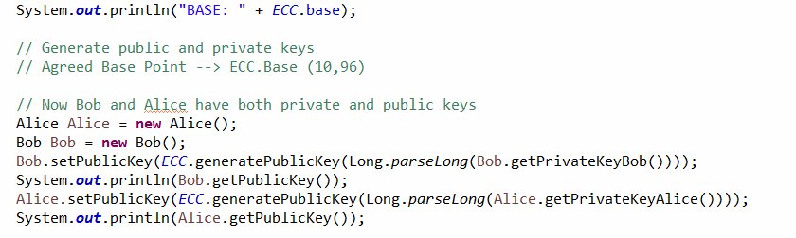
Key generation
Bob secret + private key
Alice secret + private key
Bob and Alice chooses a private key in advance

Slide 6

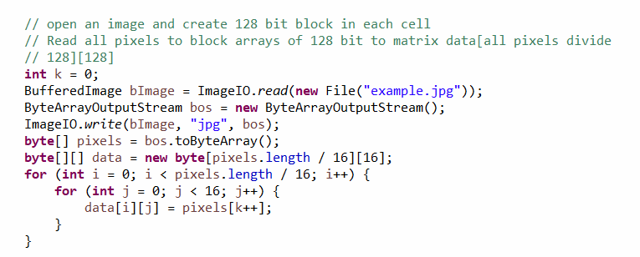
Picture pixel division
In order to work with Mars algorithm, we need to divide the image matrix into 128-bit blocks

Slide 7
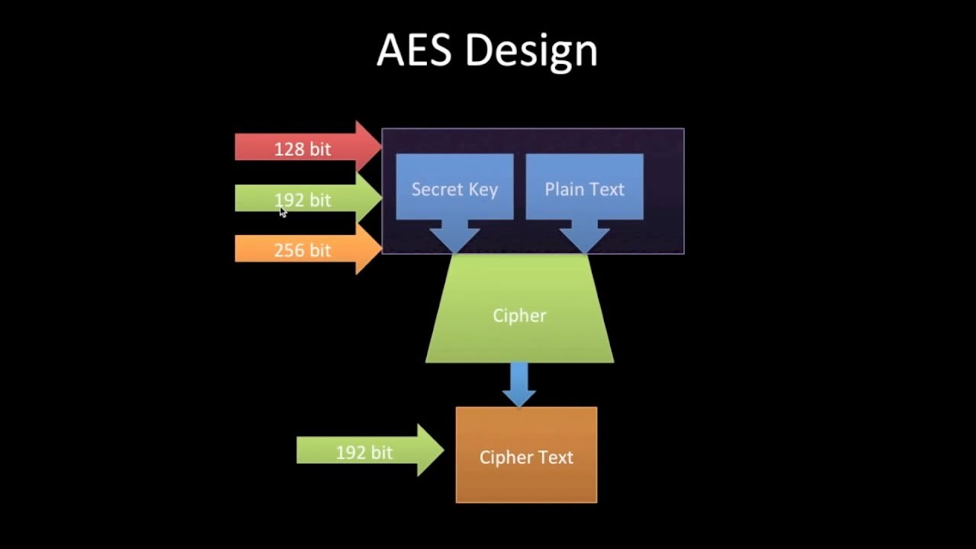
AES
private key symmetric block cipher
128-bit data, 128/192/256-bit keys
stronger & faster than Triple-DES

Slide 8

MARS
Mars is a block cipher that was IBM submission to the AES process.
MARS was selected as an AES finalist algorithm of Advanced Encryption Standard process.
- 128-bit block size and a variable key size of between 128 and 448 bits.
- shared-key (symmetric) block cipher
- resulting in a much-improved security/performance tradeoff over existing ciphers
- c and java support

Slide 9
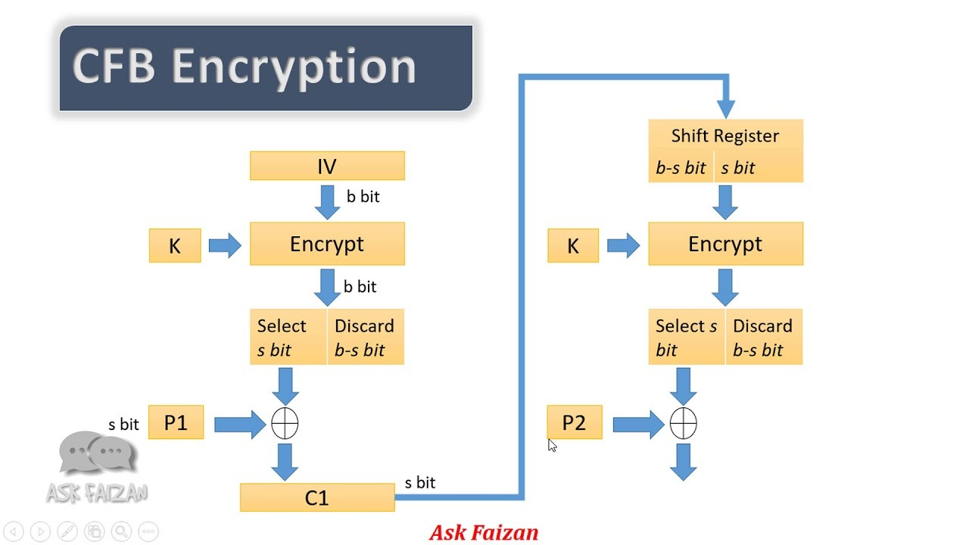
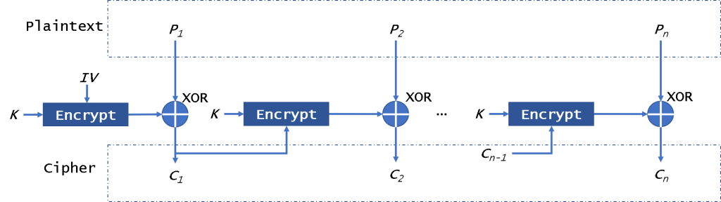
CFB mode
Encryption

Slide 10
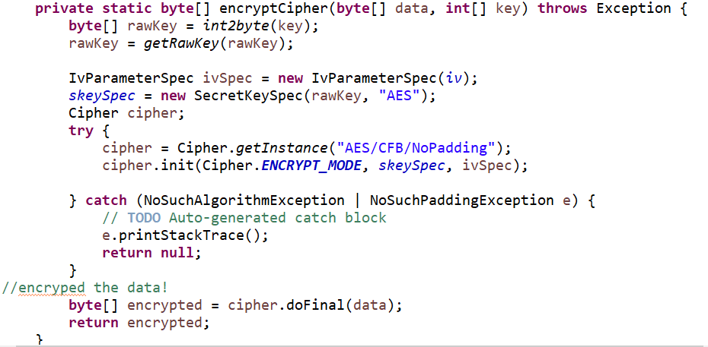
Image Encryption

Slide 11

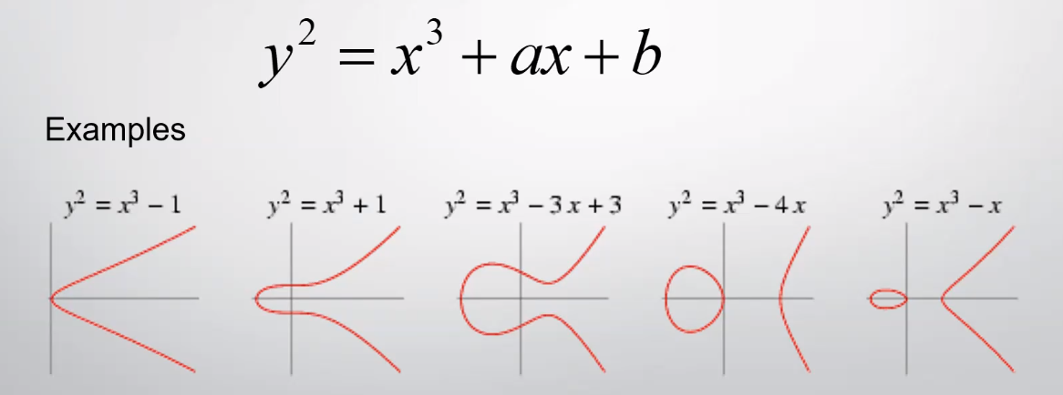
ECC

Slide 12
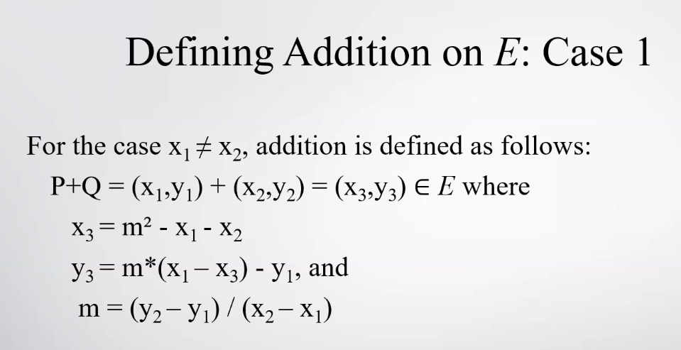
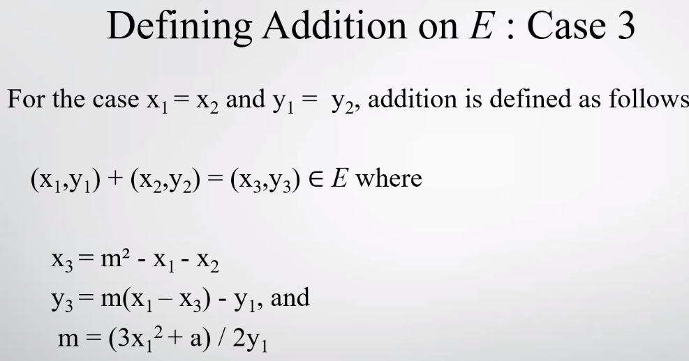
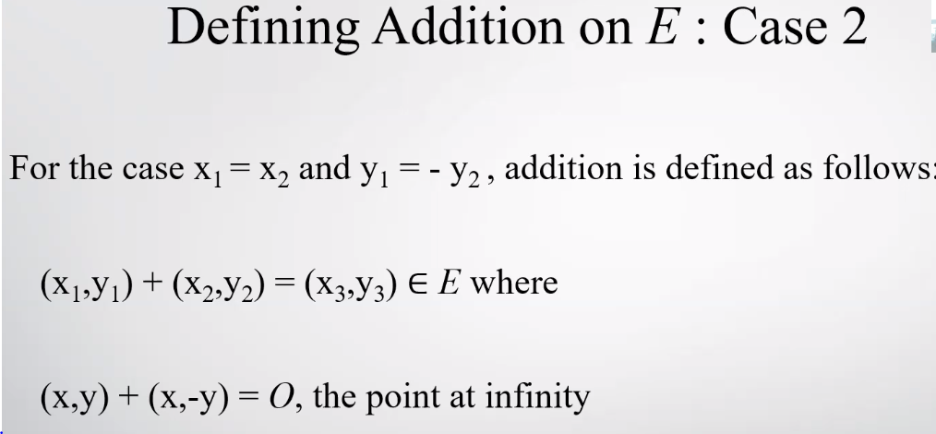
Ecc -equations

Slide 13
El Gamal encryption system is an asymmetric key encryption algorithm for public-key cryptography
El Gamal

Slide 14


El Gamal

Slide 15
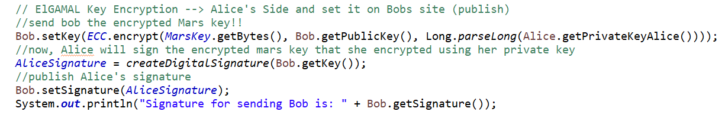
El-Gamal Mars key encryption
Create digital signature
Publish digital signature

Slide 16
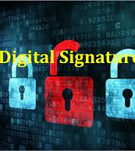
Digital Signature
Digital signature is a tool that verify the identity of the message sender that sent from one side to another and ensure the document being unchanged during transmission.
The signature provides:
- authentication.
- data integrity.
- nonrepudiation.

Slide 17

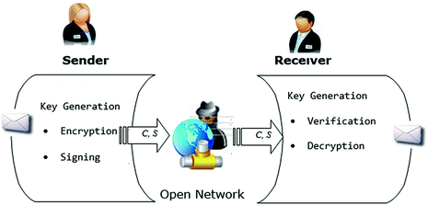
RSA
RSA is a public-key cryptosystem that is widely used for secure data transmission and the first widely marketed software package to offer digital signature using RSA algorithm

Slide 18
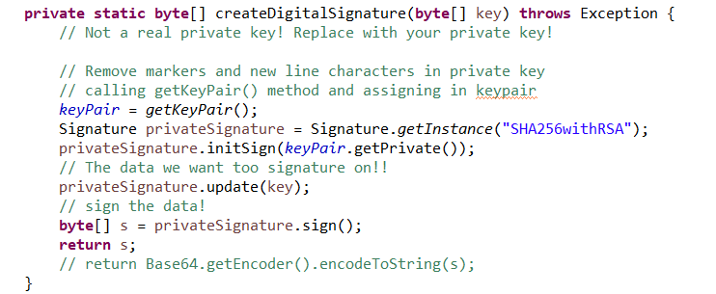
Digital Signature in our code

Slide 19
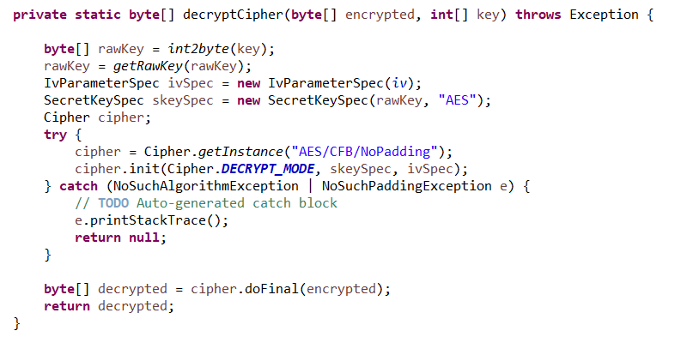

Image Decryption

Slide 20


Slide 21
Bibliography
https://en.wikipedia.org/wiki/Digital_signature
https://www.highgo.ca/2019/08/08/the-difference-in-five-modes-in-the-aes-encryption-algorithm/
https://en.wikipedia.org/wiki/MARS_(cipher)
https://he.wikipedia.org/wiki/%D7%A6%D7%95%D7%A4%D7%9F_%D7%90%D7%9C-%D7%92%D7%9E%D7%90%D7%9C
https://en.wikipedia.org/wiki/RSA_(cryptosystem)#Signing_messages
https://www.tutorialspoint.com/cryptography/block_cipher_modes_of_operation.htm
https://crypto.stackexchange.com/questions/2476/cipher-feedback-mode

